Slide 1
TDD Foundations

Slide 2
Outline
The definition of unit
The TDD cycle of red-green-refactor
The three rules of TDD
Why you should never skip observing test failure
Mind-sets for success
Mechanics for success

Slide 3
Unit Test
A single unit test consists of a descriptive name and a series of code state-ments, conceptually divided into four (ordered) parts.
1.(Optional) statements that set up a context for execution
2.One or more statements to invoke the behavior you want to verify
3.One or more statements to verify the expected outcome
4.(Optional) cleanup statements (for example, to release allocated memory)

Slide 4
Test-Driving Units
You use TDD to test-drive new behavior into your system in quite small increments.
In other words, to add a new piece of behavior to the system, you first write a test to define that behavior.
The existence of a test that will not pass forces (drives) you to implement the corresponding behavior.

Slide 5
Quite small Unit Test
Your favorite tests contain one, two, or three lines with one assertion.
You don’t seek to write tests that cover a wide swath of functionality. The responsibility for such end-to-end tests lies elsewhere, perhaps in the realm of acceptance tests/customer tests or system tests.

Slide 6
Integration Test VS Unit Test
Integration tests verify code that must integrate with other code or with external entities (the file system, databases, web protocols, and other APIs). In contrast, unit tests allow you to verify units in isolation from other code.

Slide 7
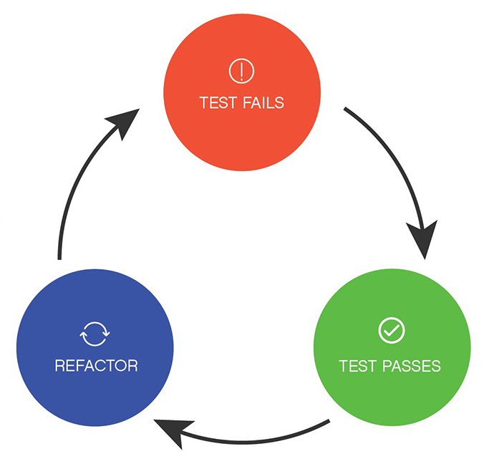
TDD Cycle
1.Write a test (“red”).
2.Get the test to pass (“green”).
3.Optimize the design (“refactor”).

Slide 8
Refactoring
You refactor (a term popularized by Martin Fowler’sRefactoring: Improving the Design of Existing Code) when you improve your code’s design without changing its behavior, something that having tests allows you to safely do.

Slide 9
The Three Rules of TDD
Robert C. Martin (“Uncle Bob”) provides a concise set of rules for practicing TDD.
1.Write production code only to pass a failing unit test.
2.Write no more of a unit test than sufficient to fail (compilation failures are failures).
3.Write no more production code than necessary to pass the one failing unit test.

Slide 10
Getting Green on Red
Running the wrong tests
Testing the wrong code
Unfortunate test specification
Invalid assumptions about the system
Suboptimal test order
Linked production code
Overcoding
Testing for confidence

Slide 11
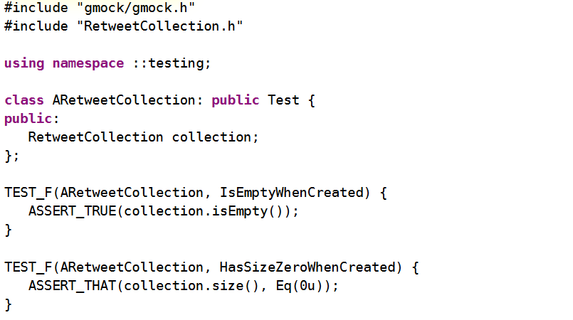

Slide 12
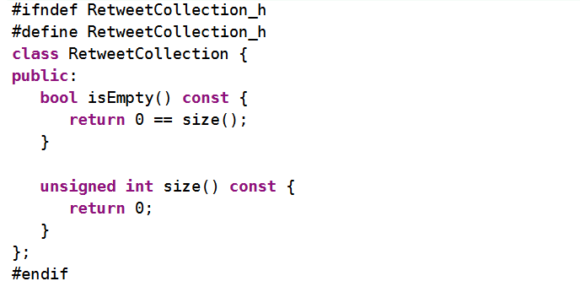

Slide 13
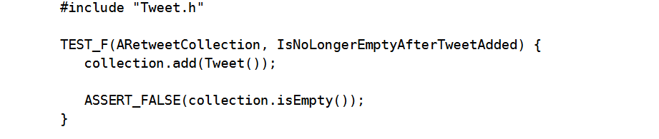

Slide 14
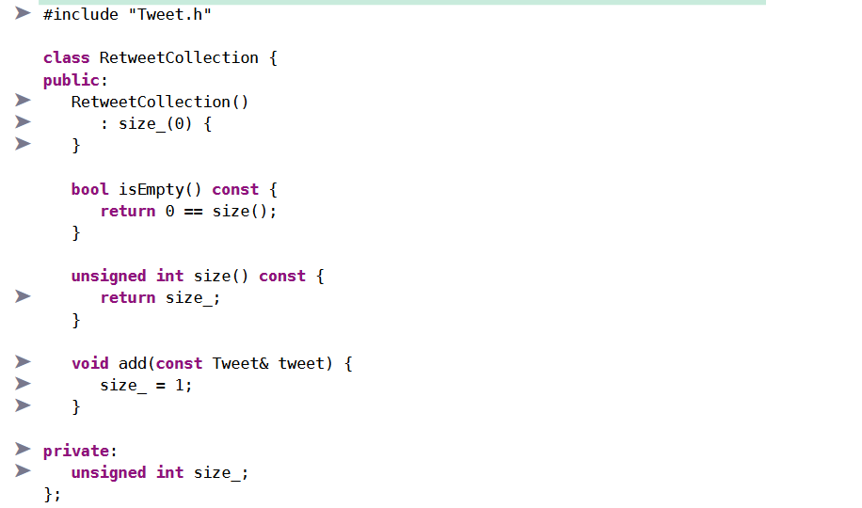

Slide 15
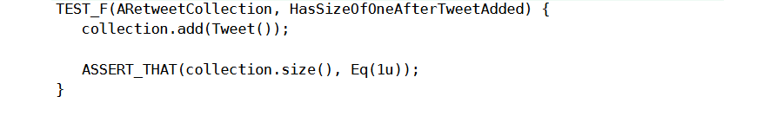

Slide 16
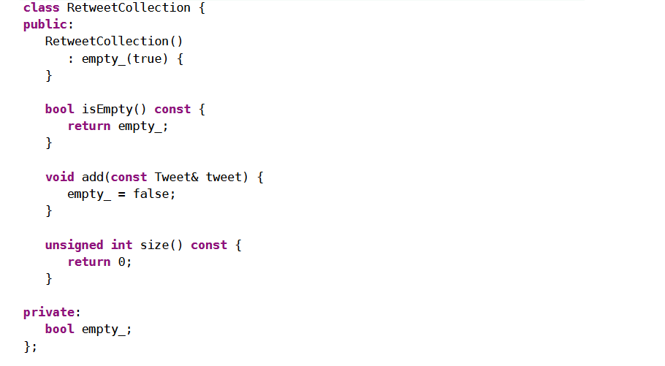

Slide 18
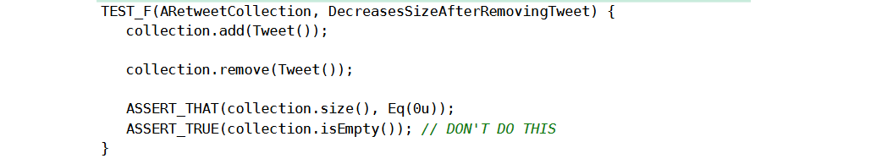

Slide 19
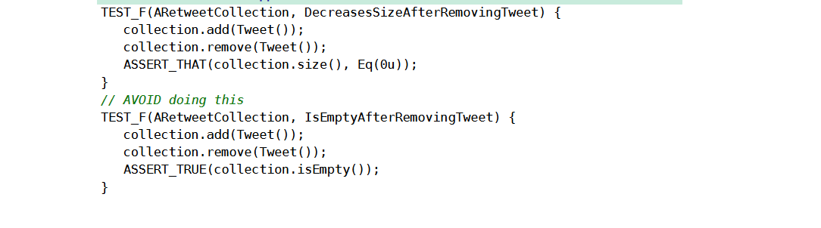

Slide 20
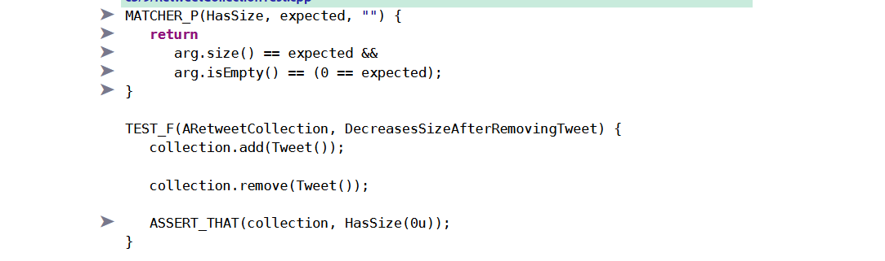

Slide 21
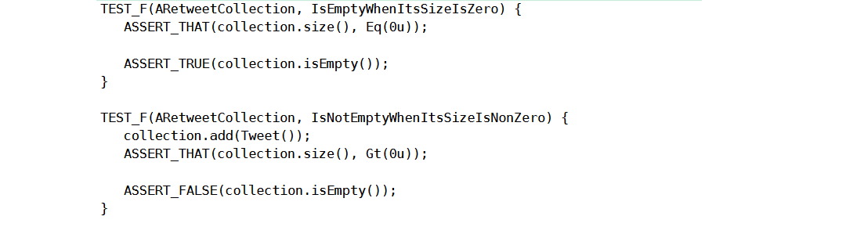

Slide 22
Mind-Sets for Successful Adoption of TDD
Incrementalism
Test Behavior, Not Methods
Using Tests to Describe Behavior
Keeping It Simple
Sticking to the Cycle

Slide 23
Mechanics for Success
What’s the Next Test?
Ten-Minute Limit
Defects
Disabling Tests

